Slide 1
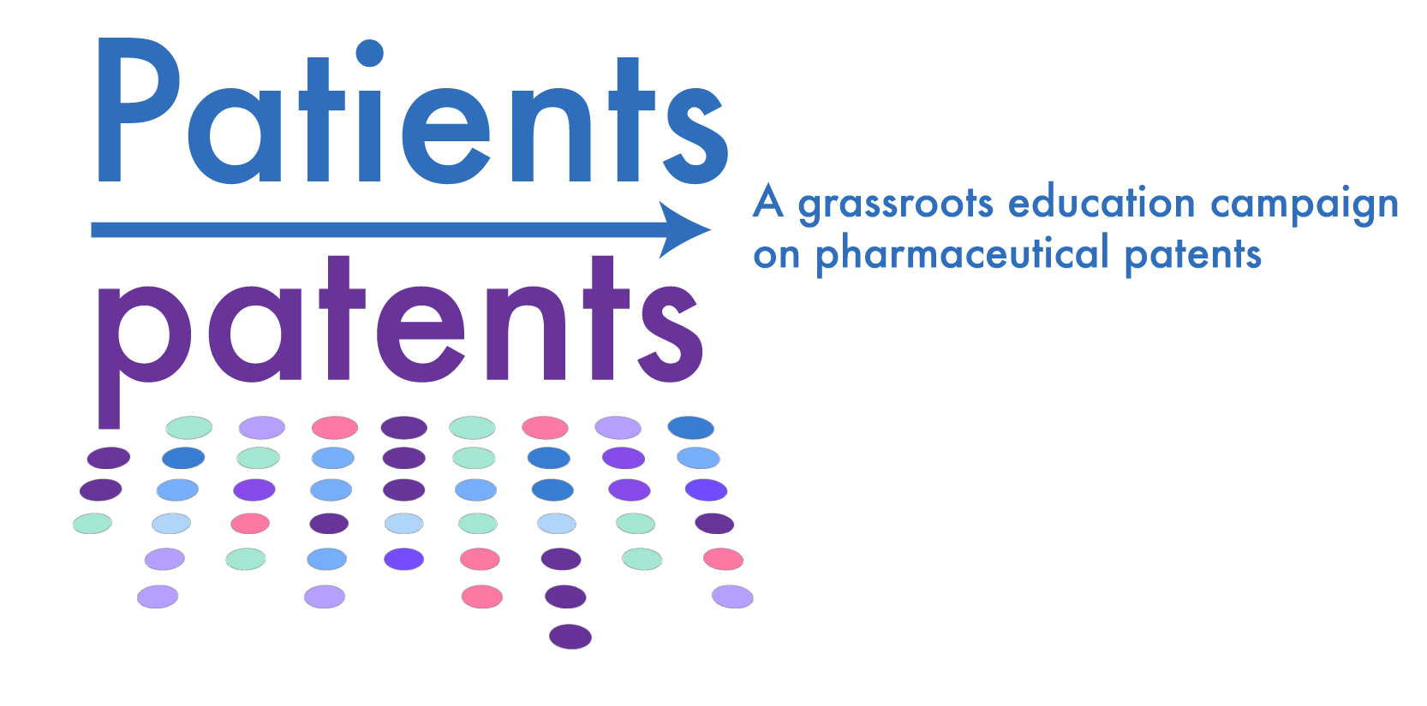



Social Media Kit:
Patients and patents campaign
This kit includes images and posts you can use for the Patients and patents campaign on your social media platforms.
Each slide provides an image and a social media post you can use with that image, or you can create your own original post following the theme or key message found on the image.
To download the image, please right click on the image and select “Save as picture”.
To use the post, please highlight the post, then copy and paste for use on your social media platform. Remember to use this hashtag: #Patientsandpatents

Slide 2
Patients and patents:
Websites and social media information
Asset | Patients and patents | Arthritis Consumer Experts | Australian Patient Advocacy Alliance | Crohn’s & Colitis Foundation
Website | https://advocacy.jointhealth.org/patients-and-patents/ | www.jointhealth.org | www.patientadvocacyalliance.org.au | www.crohnscolitisfoundation.org
Facebook | X | @ACEJointHealth | X | @ccfafb
Instagram | X | @ACEJointHealth | X | @crohnscolitisfoundation
X | X | @ACEJointHealth | X | @CrohnsColitisFn
BlueSky | X | @ACEJointHealth | X | @crohnscolitisfdn
LinkedIn | X | Arthritis Consumer Experts | Australian Patient Advocacy Alliance | Crohn’s & Colitis Foundation
YouTube | X | @JointHealth | X | @CrohnsColitisFoundation
TikTok | X | X | X | @crohnscolitisfoundation
Infographic | Click to download | X | X | X

Slide 3

Logo (Square)

Slide 4

Logo (Rectangle with tagline)

Slide 5
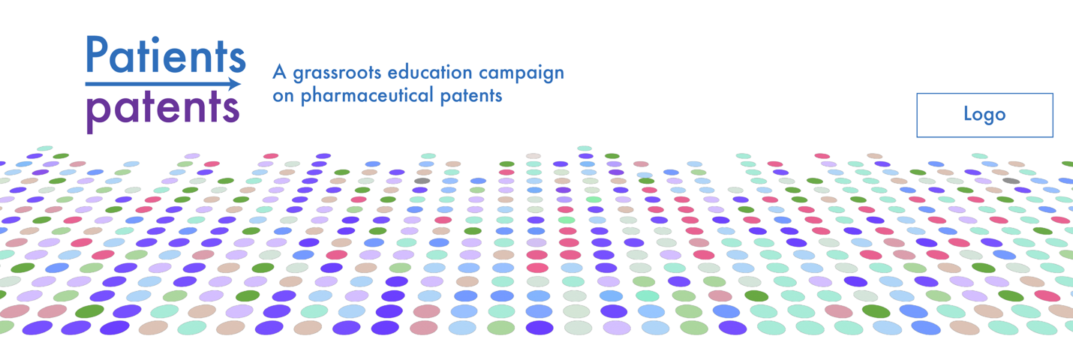
Logo (Header image with option to add your own logo)

Slide 6
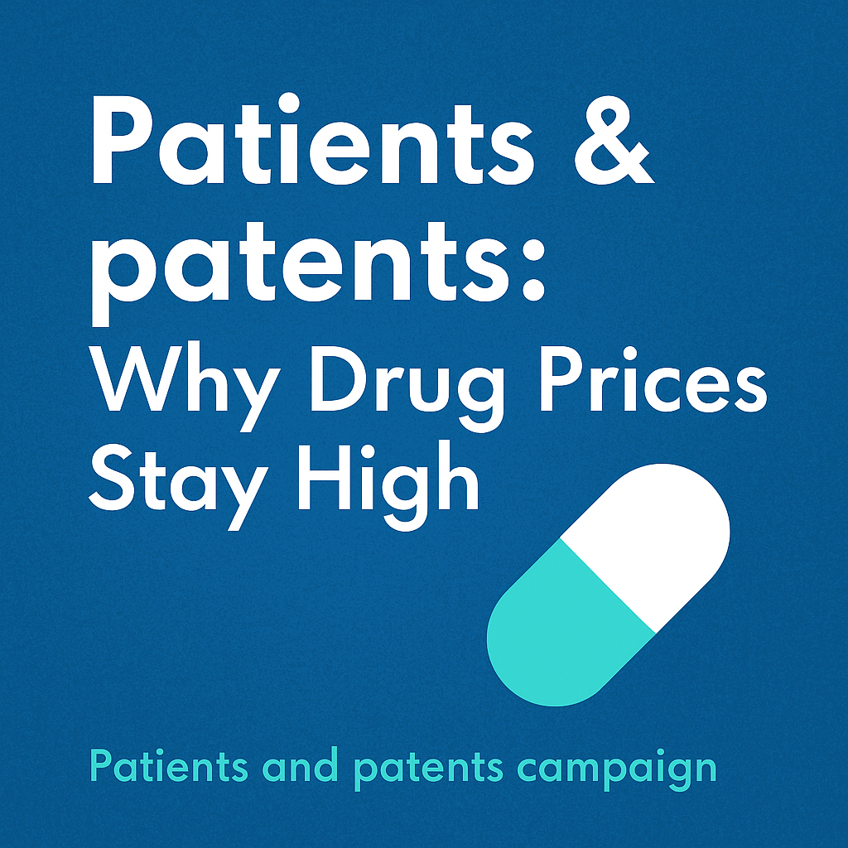
Image Name: Image 1
Social Media Post:
Arthritis Consumer Experts, together with Australian Patient Advocacy Alliance and Crohn’s & Colitis Foundation, have launched the #Patientsandpatents campaign to increase patient community and public understanding of drug patents.
Learn more: https://advocacy.jointhealth.org/patients-and-patents/
@ACEJointHealth @CrohnsColitisFn

Slide 7


What is a pharmaceutical patent?
Image Name: Image 2
Social Media Post:
A pharmaceutical patent is a form of legal protection that gives a pharmaceutical manufacturer the exclusive right to sell a new original-brand medication for a certain period of time.
Learn more: https://advocacy.jointhealth.org/patients-and-patents/
#Patientsandpatents
@ACEJointHealth @CrohnsColitisFn
It takes 10-15 years to develop a new medication
Patent can be filed at any time during the development process
Gives companies exclusive rights to sell a medication for 20 years in Canada
#Patientsandpatents

Slide 8



How patents
are misused
Image Name: Image 3
Social Media Post:
Pharmaceutical patents can be misused to keep prices high and delay access to more affordable generic & biosimilar medications. Patients should not be forced to choose between paying for medications or for essentials like food or housing.
Join the conversation: https://advocacy.jointhealth.org/patients-and-patents/
#PatientsandPatents #AccesstoMeds
@ACEJointHealth @CrohnsColitisFn
Creates monopolies on original-brand medication
Delays competition from medications like generics and biosimilars
Forces patients and healthcare systems to pay for medications at higher “patented price”
#Patientsandpatents

Slide 9


Impact on
patients
Image Name: Image 4
Social Media Post:
What good is a breakthrough medication if you can’t afford it? Patent manipulation can keep medication prices artificially high. For patients who can’t afford them, high costs force many to skip or ration their medication.
Learn more: https://advocacy.jointhealth.org/patients-and-patents/
#PatientsandPatents #TrueInnovation #AffordableHealthcare
@ACEJointHealth @CrohnsColitisFn
Increases risk of worsening disease control and work disability
High costs for medicines forces patients to skip or ration medication
Reduced quality of life as patients are forced to pick between paying for medications and essentials like food or housing
With fewer treatment choices, patients may be limited to medications that don’t work well for them or cause more side effects
#Patientsandpatents

Slide 10


Impact on
healthcare system
Image Name: Image 5
Social Media Post:
Pharmaceutical patents should protect innovation for a set period. Some manufacturers use legal maneuvers to extend patents for years beyond their original terms, delaying competition from less costly biosimilars that are safe and effective.
Learn more: https://advocacy.jointhealth.org/patients-and-patents/
#PatientsandPatents #AffordableMedsNow
@ACEJointHealth @CrohnsColitisFn
Billions in lost savings for public and private drug plans
Reduced money and resources for hospitals, research, and new care
Longer wait times for care due to stretched budgets
Less competition means there’s less pressure on pharmaceutical manufacturers to bring new medications to market
#Patientsandpatents

Slide 11




The benefits of post-patent medications
Image Name: Image 6
Social Media Post:
Post-patent medications benefit patients and healthcare systems in many ways:
Make medication more affordable
Improve medication adherence
Allow health care providers to create personalized treatment plans
Learn more: https://advocacy.jointhealth.org/patients-and-patents/
#PatientsandPatents #AffordableMedsNow
@ACEJointHealth @CrohnsColitisFn
Generics = up to 95% cheaper
Biosimilars = 30-50% cheaper
Lower research costs
Affordability improves medication adherence = better health outcomes
Allow health care providers to tailor treatment plans based on patient needs rather than what patient can afford
Increase treatment options for doctors and patients
#Patientsandpatents

Slide 12






Image Name: Image 7
Social Media Post:
Patent games are hurting health equity.
1 in 4 Canadians struggle to afford their prescriptions. Some pharmaceutical manufacturers use legal maneuvers in the patent system to delay affordable medications from entering the market.
Read more: https://advocacy.jointhealth.org/patients-and-patents/
#PatientsandPatents #DrugPatents #HealthEquity
@ACEJointHealth @CrohnsColitisFn
More patent learning resources for patients
#Patientsandpatents

Slide 13

Image Name: Image 8
Social Media Post:
Join the #Patientsandpatents campaign today to:
•Increase awareness about the impact of patents on patients and the healthcare system
•Promote health equity
•Increase treatment options for patients
Join now: https://advocacy.jointhealth.org/patients-and-patents/
#PatientsandPatents #AffordableMedsNow
@ACEJointHealth @CrohnsColitisFn
Join the
Patients and patents campaign today!
#Patientsandpatents

